Slide 1
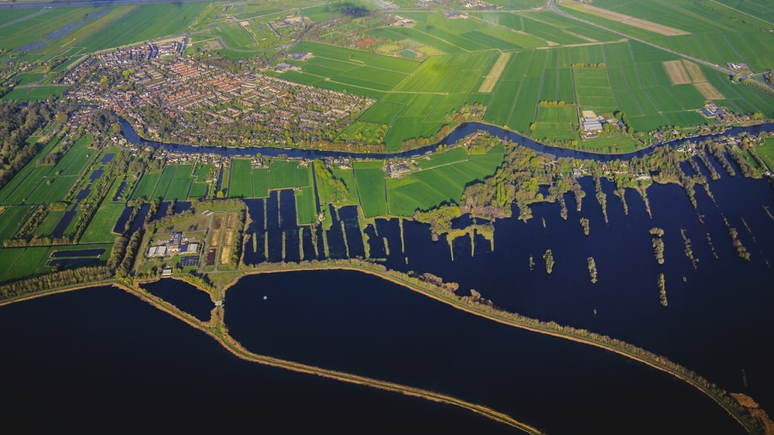
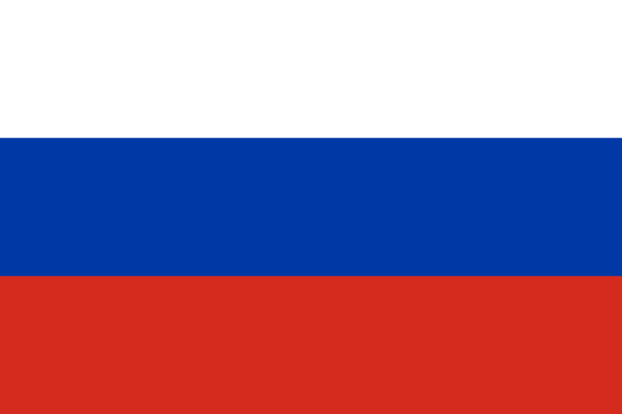
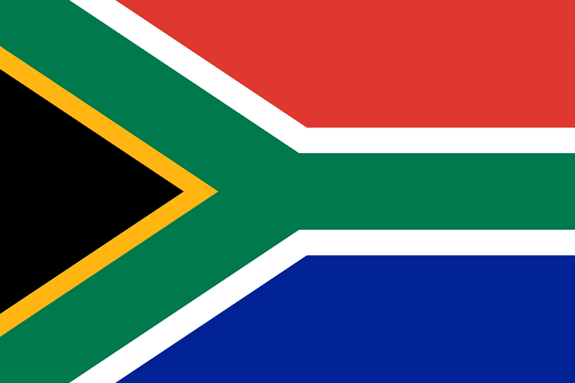
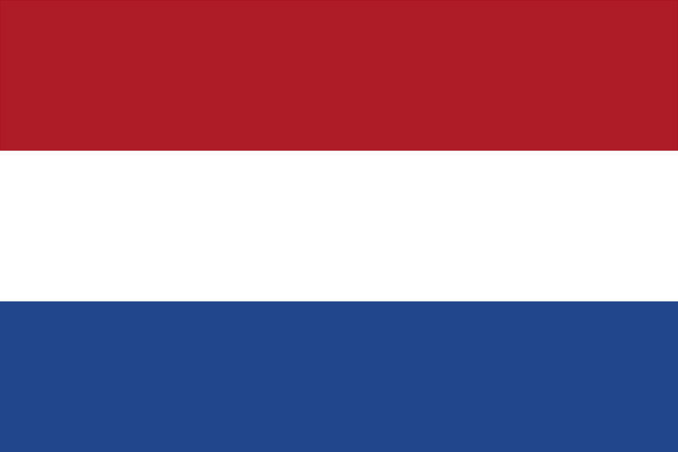
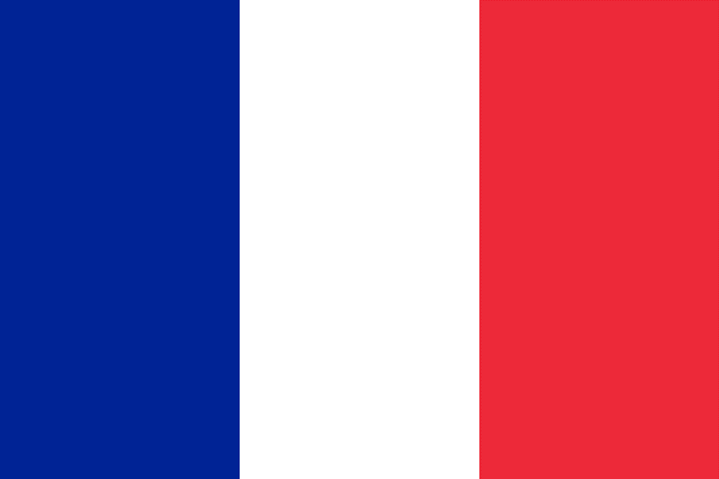
Number
20
Number
19
Number
18
Number
17
Russia
South Africa
Netherlands
France
Country with the most
landmass
Country with the
coolest flag
Country with the
best DJ’s
Country with the
city of love

Slide 2
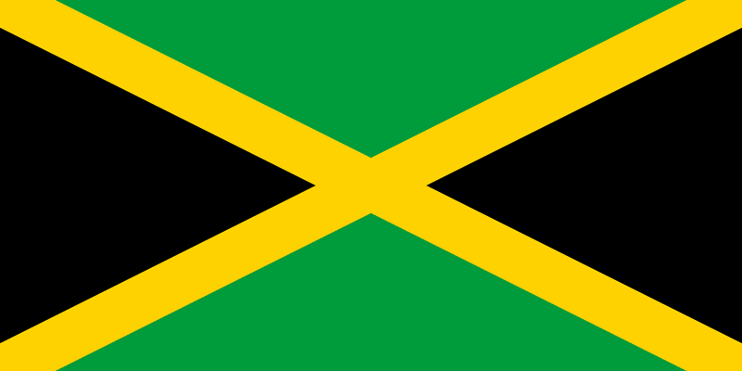
Number
20
Number
19
Number
18
Number
17
Number
16
Russia
South Africa
Netherlands
France
Jamaica
Country with the most
landmass
Country with the
coolest flag
Country with the
best DJ’s
Country with the
city of love
Just a very cool country

Slide 3
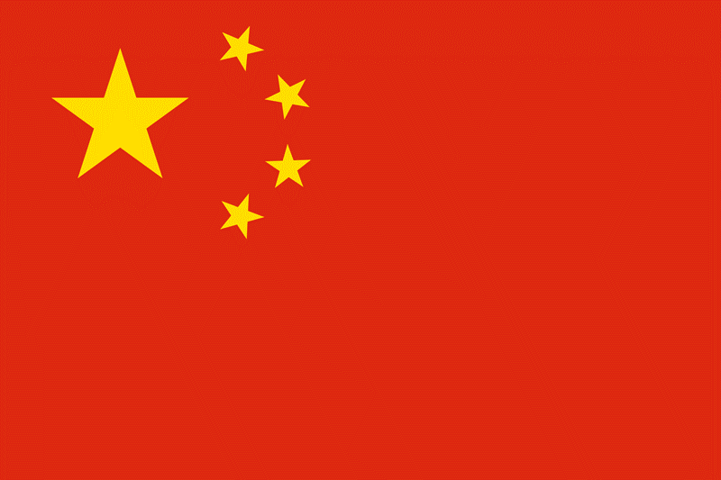
Number
19
Number
18
Number
17
Number
16
Number
15
South Africa
Netherlands
France
Jamaica
China
Country with the
coolest flag
Country with the
best DJ’s
Country with the
city of love
Just a very cool country
Country with the highest
population

Slide 4
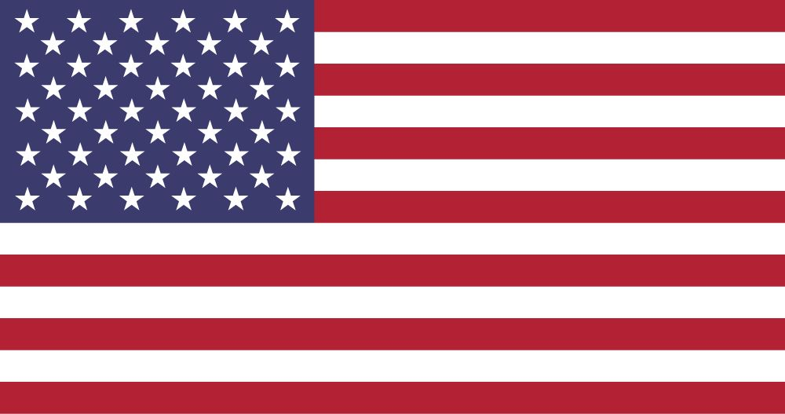
Number
18
Number
17
Number
16
Number
15
Number
14
Netherlands
France
Jamaica
China
United States
Country with the
best DJ’s
Country with the
city of love
Just a very cool country
Country with the highest
population
Country with the biggest
music industry

Slide 5
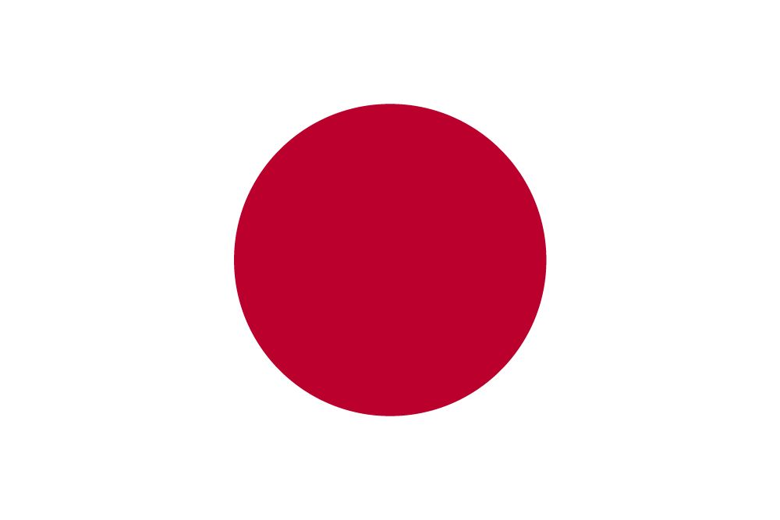
Number
17
Number
16
Number
15
Number
14
Number
13
France
Jamaica
China
United States
Japan
Country with the
city of love
Just a very cool country
Country with the highest
population
Country with the biggest
music industry
Home to anime and
J-POP

Slide 6
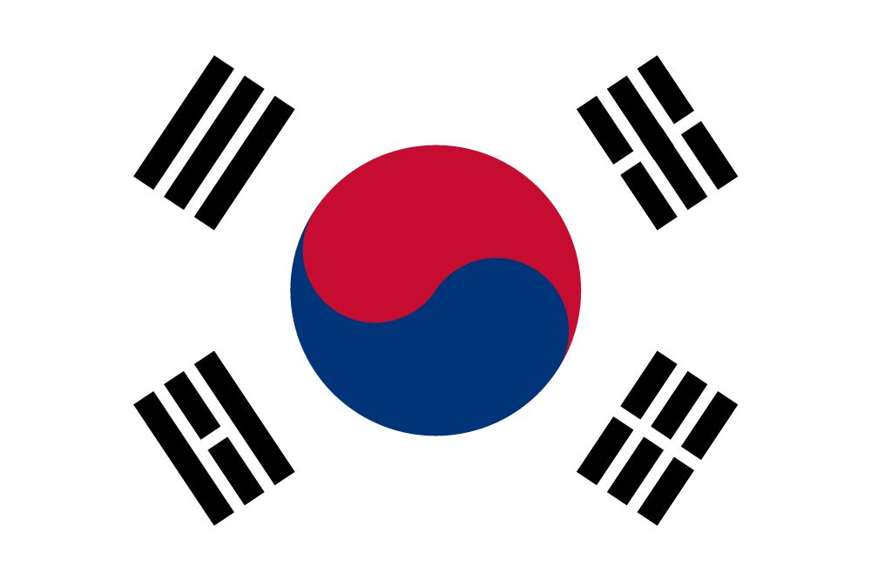
Number
16
Number
15
Number
14
Number
13
Number
12
Jamaica
China
United States
Japan
South Korea
Just a very cool country
Country with the highest
population
Country with the biggest
music industry
Home to anime and
J-POP
Home to K-POP

Slide 7
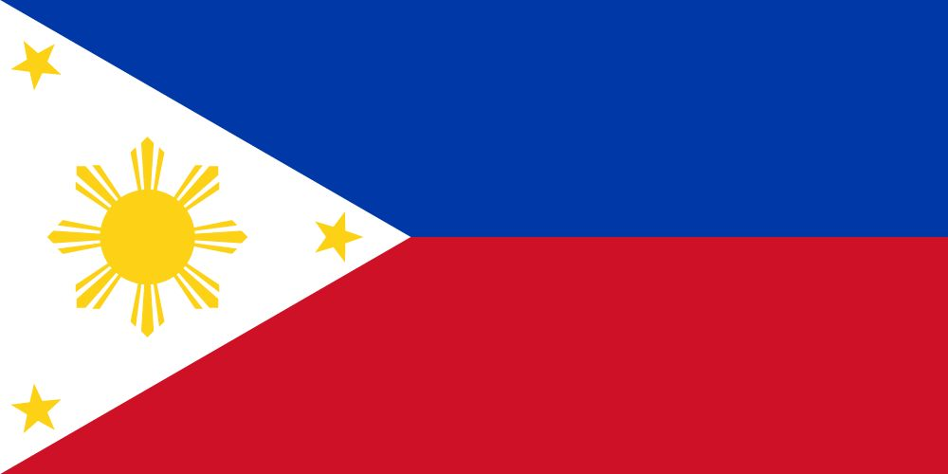
Number
15
Number
14
Number
13
Number
12
Number
11
China
United States
Japan
South Korea
Philippines
Country with the highest
population
Country with the biggest
music industry
Home to anime and
J-POP
Home to K-POP
Most of my subscribers
come from this country

Slide 8
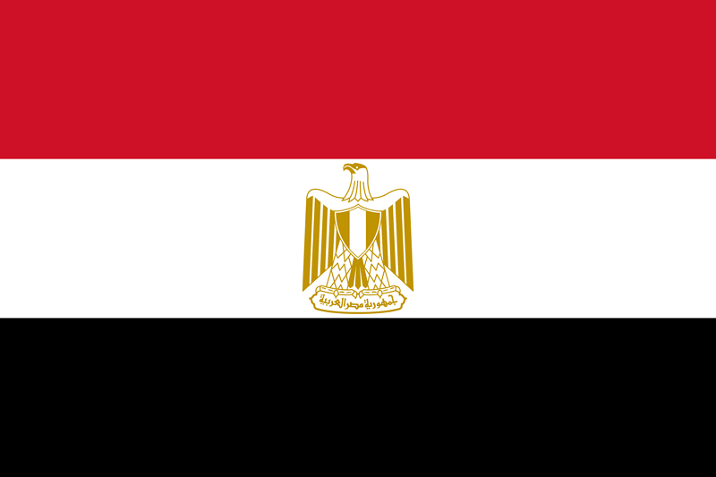
Number
14
Number
13
Number
12
Number
11
Number
10
United States
Japan
South Korea
Philippines
Egypt
Country with the biggest
music industry
Home to anime and
J-POP
Home to K-POP
Most of my subscribers
come from this country
Country with rich
history

Slide 9

Number
13
Number
12
Number
11
Number
10
Number
9
Japan
South Korea
Philippines
Egypt
Zimbabwe
Home to anime and
J-POP
Home to K-POP
Most of my subscribers
come from this country
Country with rich
history
Country with the highest
literacy rate in Africa

Slide 10
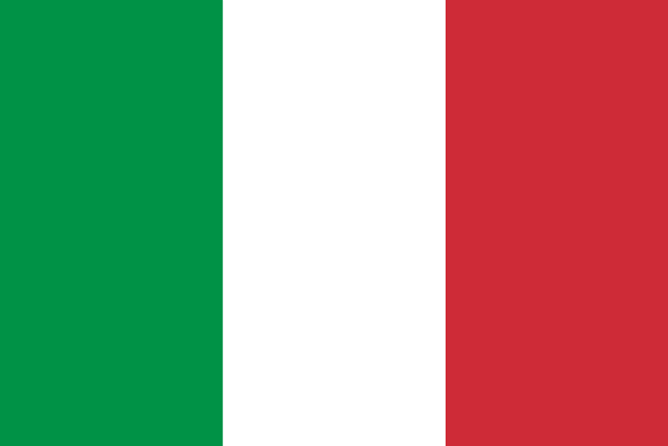
Number
12
Number
11
Number
10
Number
9
Number
8
South Korea
Philippines
Egypt
Zimbabwe
Italy
Home to K-POP
Most of my subscribers
come from this country
Country with rich
history
Country with the highest
literacy rate in Africa
Home to one of the
‘Wonders of the World’

Slide 11
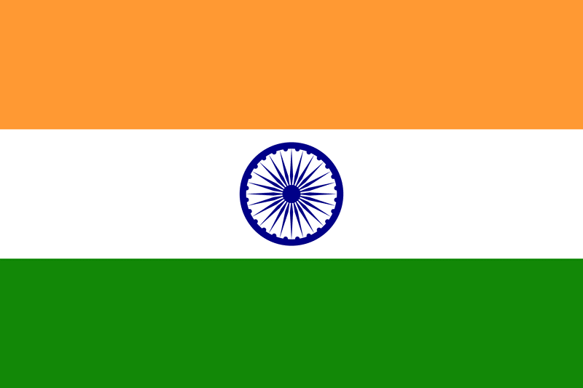
Number
11
Number
10
Number
9
Number
8
Number
7
Philippines
Egypt
Zimbabwe
Italy
India
Most of my subscribers
come from this country
Country with rich
history
Country with the highest
literacy rate in Africa
Home to one of the
‘Wonders of the World’
Home to Bollywood

Slide 12
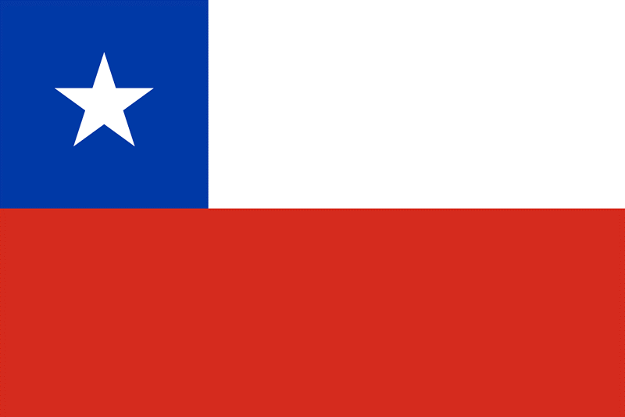
Number
10
Number
9
Number
8
Number
7
Number
6
Egypt
Zimbabwe
Italy
India
Chile
Country with rich
history
Country with the highest
literacy rate in Africa
Home to one of the
‘Wonders of the World’
Home to Bollywood
The country of poets

Slide 13
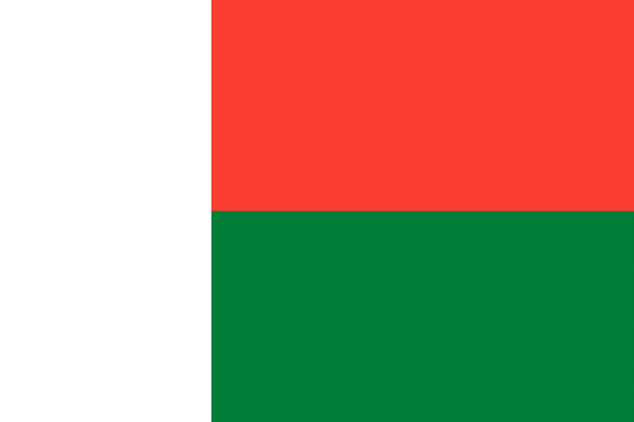
Number
9
Number
8
Number
7
Number
6
Number
5
Zimbabwe
Italy
India
Chile
Madagascar
Country with the highest
literacy rate in Africa
Home to one of the
‘Wonders of the World’
Home to Bollywood
The country of poets
4th biggest island and
Is a country as well

Slide 14
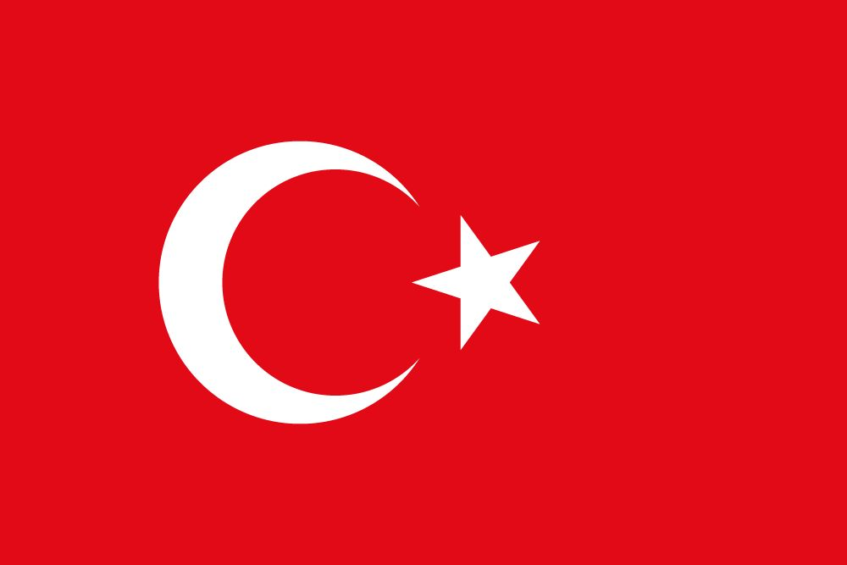
Number
8
Number
7
Number
6
Number
5
Number
4
Italy
India
Chile
Madagascar
Turkey
Home to one of the
‘Wonders of the World’
Home to Bollywood
The country of poets
4th biggest island and
Is a country as well
Country that lies in
Two different continents

Slide 15
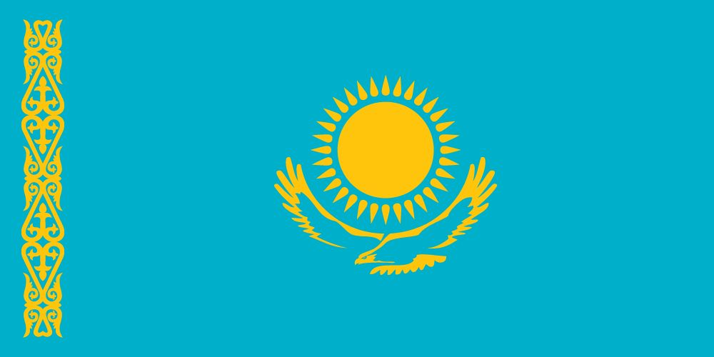
Number
7
Number
6
Number
5
Number
4
Number
3
India
Chile
Madagascar
Turkey
Kazakhstan
Home to Bollywood
The country of poets
4th biggest island and
Is a country as well
Country that lies in
Two different continents
The largest landlocked
country in the world

Slide 16
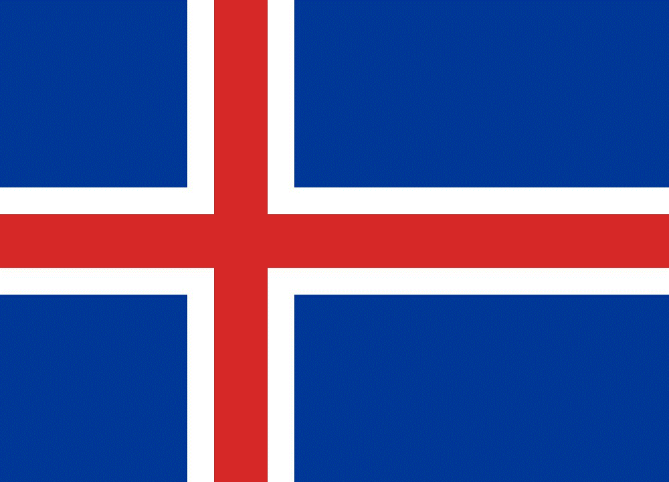
Number
6
Number
5
Number
4
Number
3
Number
2
Chile
Madagascar
Turkey
Kazakhstan
Iceland
The country of poets
4th biggest island and
Is a country as well
Country that lies in
Two different continents
The largest landlocked
country in the world
Should be swapping
names with Greenland

Slide 17
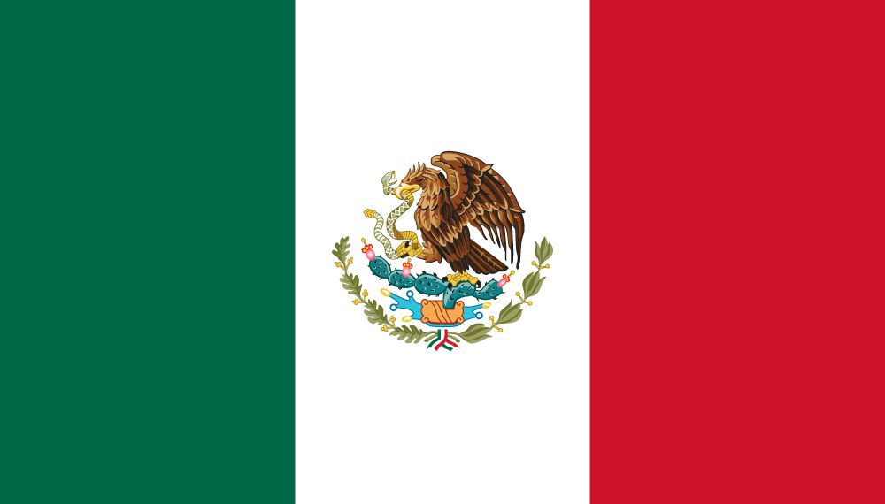
Number
5
Number
4
Number
3
Number
2
Number
1
Madagascar
Turkey
Kazakhstan
Iceland
Mexico
4th biggest island and
Is a country as well
Country that lies in
Two different continents
The largest landlocked
country in the world
Should be swapping
names with Greenland
Just very cool

Slide 18
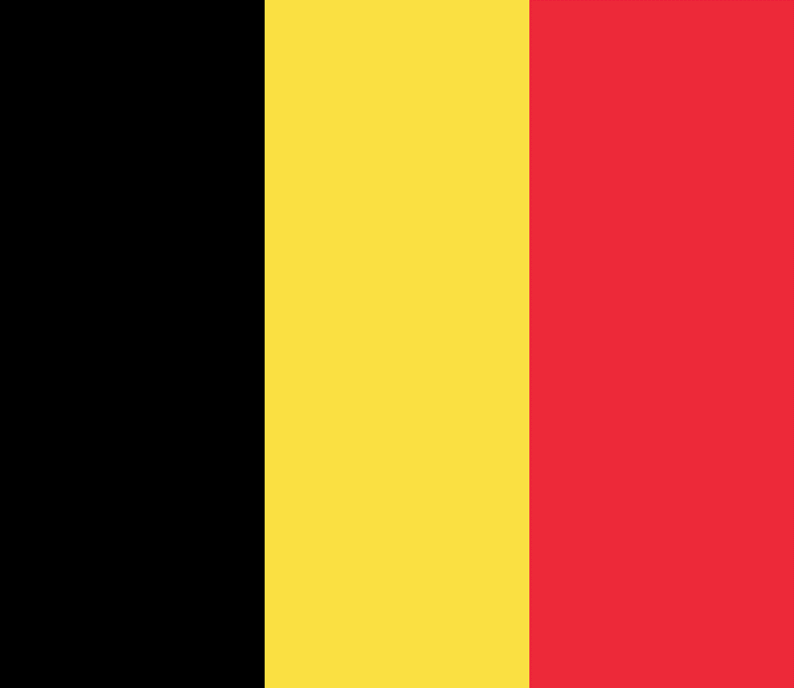
Number
4
Number
3
Number
2
Number
1
Number
0
Turkey
Kazakhstan
Iceland
Mexico
Belgium
Country that lies in
Two different continents
The largest landlocked
country in the world
Should be swapping
names with Greenland
Just very cool
Best chocolate in the
world

